Slide 1
Track 2: Robust Drug-Target Affinity for STAR AI Competition
By: Shikhar Verma & Ninh Le

Slide 2








Introduction - Binding Affinity
Millions of Candidate Molecules
Which candidate drug molecules best targets the disease-causing protein?
$$$
1 Protein on Virus
Use Machine Learning Models to predict which candidate molecules bind best

Slide 3



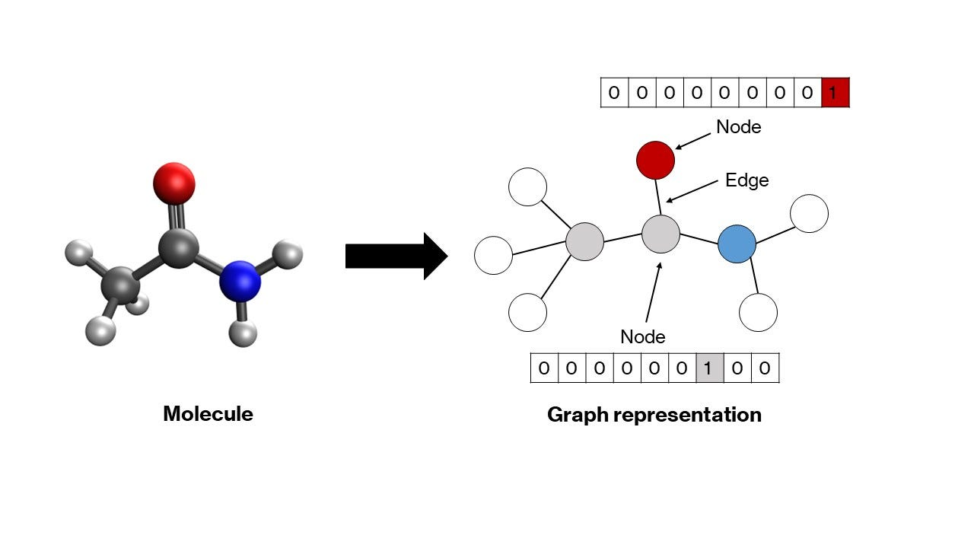
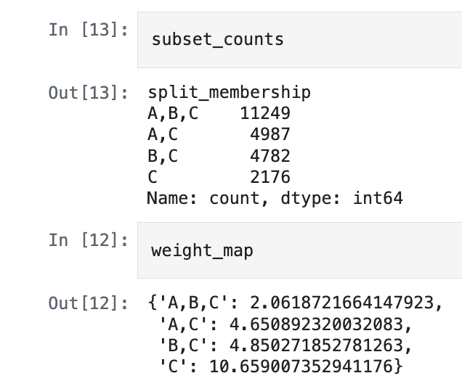
The Data & Preprocessing
MKMTLLI…
1280-dimension vector representation
ML Models are not chemists!
ESM2
Split A
(Random)
Split B (Scaffold)
Split C (Assay)
Each atom has a 29-dimensional vector representation
Each bond has a 7-dimensional vector representation

Slide 4
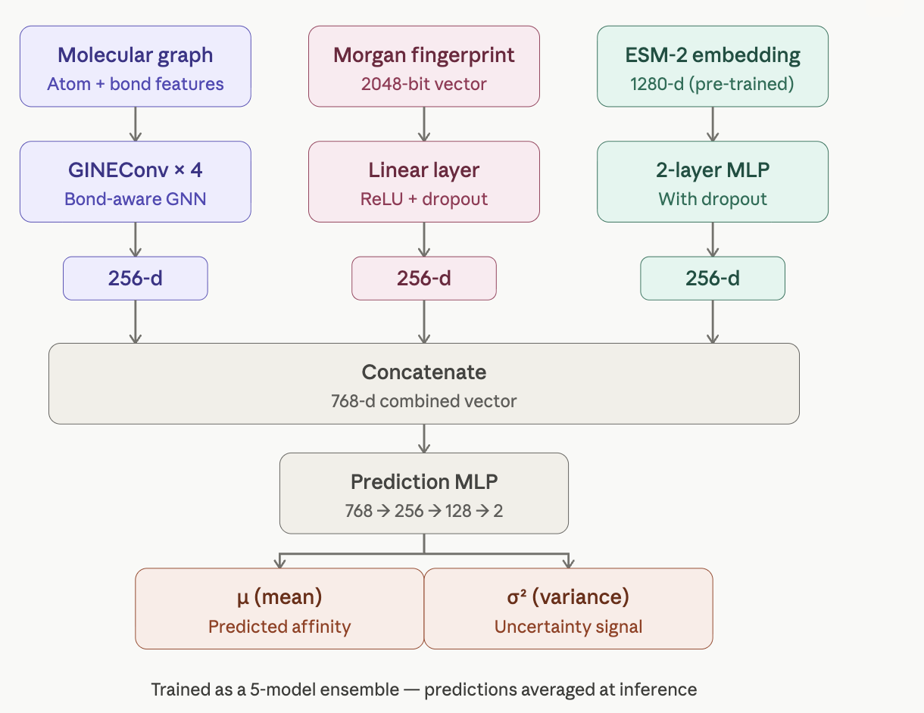
Model Architecture

Slide 5
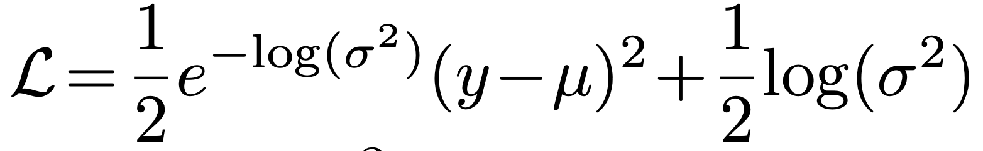
Training the model: Heteroskedastic loss
Precision
Regularizer
Adam Optimizer with Cosine Annealing learning rate scheduler
Gradient Clipping at max norm 5.0

Slide 6
Training Dataset
Train | 23,194 (Compound-Protein pairs)
Validation | 2,578 (Compound-Protein pairs)
Test | 23,191 (Compound-Protein pairs)
Inverse Frequency Weighted Sampling to ensure sufficient Split C representation

Slide 7
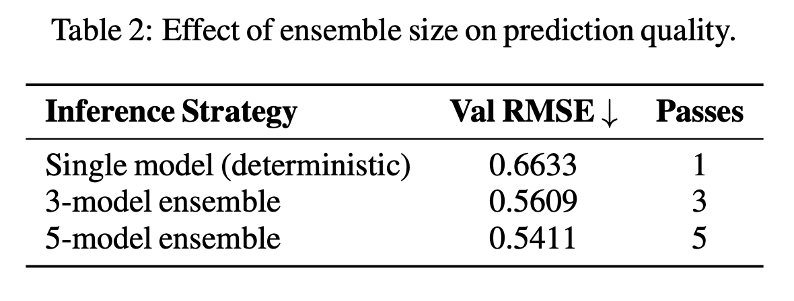
Ablation studies: Bigger ensemble size, better prediction

Slide 8
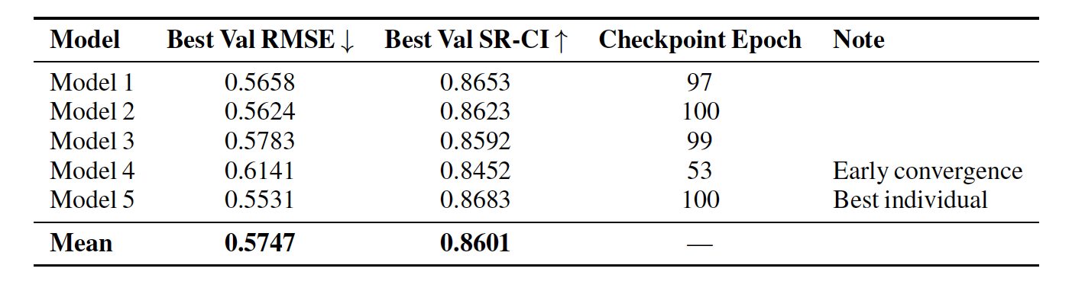
Ablation Study: SR-CI

Slide 9
STAR Analysis: Safety
Prevent over-confident recommendation by uncertainty estimation
Total variance = Epistemic uncertainty + Aleatoric uncertainty
Variance of 50 variances (10 stochastic passes x 5 models)
Mean of 50 variances

Slide 10
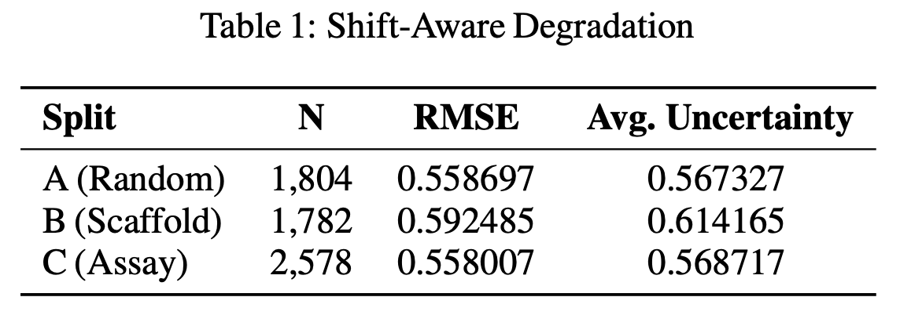
STAR Analysis: Trustworthy and Responsibility
Shift-aware evaluation by computing per-shift RMSE and CI
Report performance degradation across splits

Slide 11
STAR Analysis: Actionability
Budget-constrained compound ranking
Prioritize high-affinity, low-uncertainty compound-protein pairs
Filter for pred variance < threshold
Compute utility (pred affinity - lambda_risk * pred STD)
Rank by utility and return top k

Slide 12
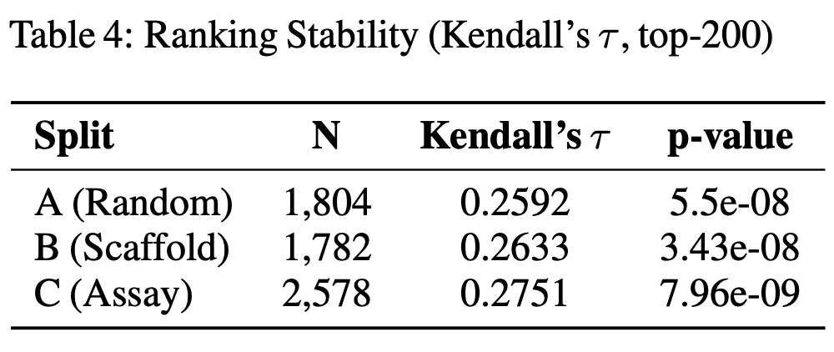
STAR evaluation metrics: Kendall’s tau for ranking stability

Slide 13
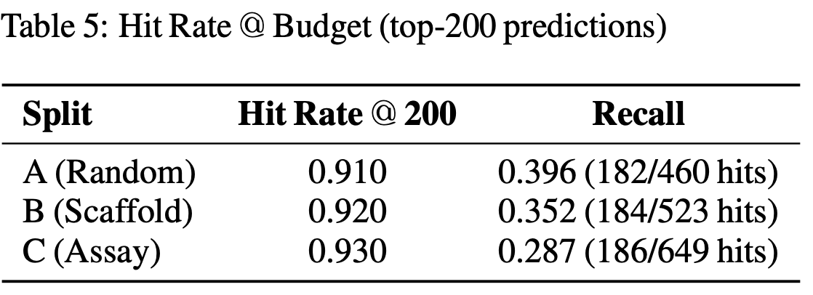
STAR evaluation metrics: Hit Rate at Budget

Slide 14
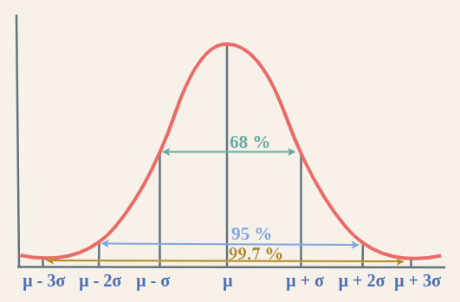
STAR evaluation metrics: Calibration
Expected Calibration Error (ECE) checks if the model’s confidence matches Gaussian distribution.
ECE = 0.0843 (recommended < 0.10)

Slide 15
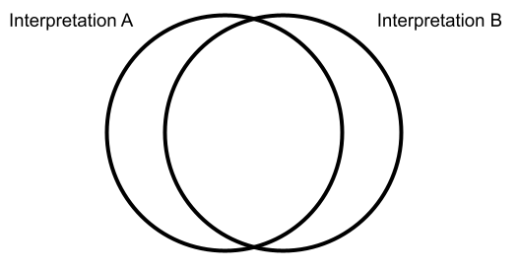
STAR evaluation metrics: Abstention quality
Top 25% uncertain prediction
Top 25% worst prediction
69%

Slide 16
Q&A

